Slide 1

Task: Realtime Prices of Elements WebApp
Presented by : RAJ PARKHI
VAIBHAV NIRMAL
AMEY DHOLE

Slide 2
Section 1: Using Web Scrapping Section 2: Using React.JS and Angular

Slide 3
Section 1: Using Web Scrapping

Slide 4
Technologies Used:
Web Scrapping
Python
Beautiful Soup

Slide 5
WEB SCRAPING CONCEPT
Client makes a--->requests to---> www.google.com--->
Server gives a index.html file--->the browser inturn beautifies it and shows on the screen.
But in web scraping--->All the html content will be taken into python and without giving it to the browser--->we would be scraping Data and saving into python...

Slide 6
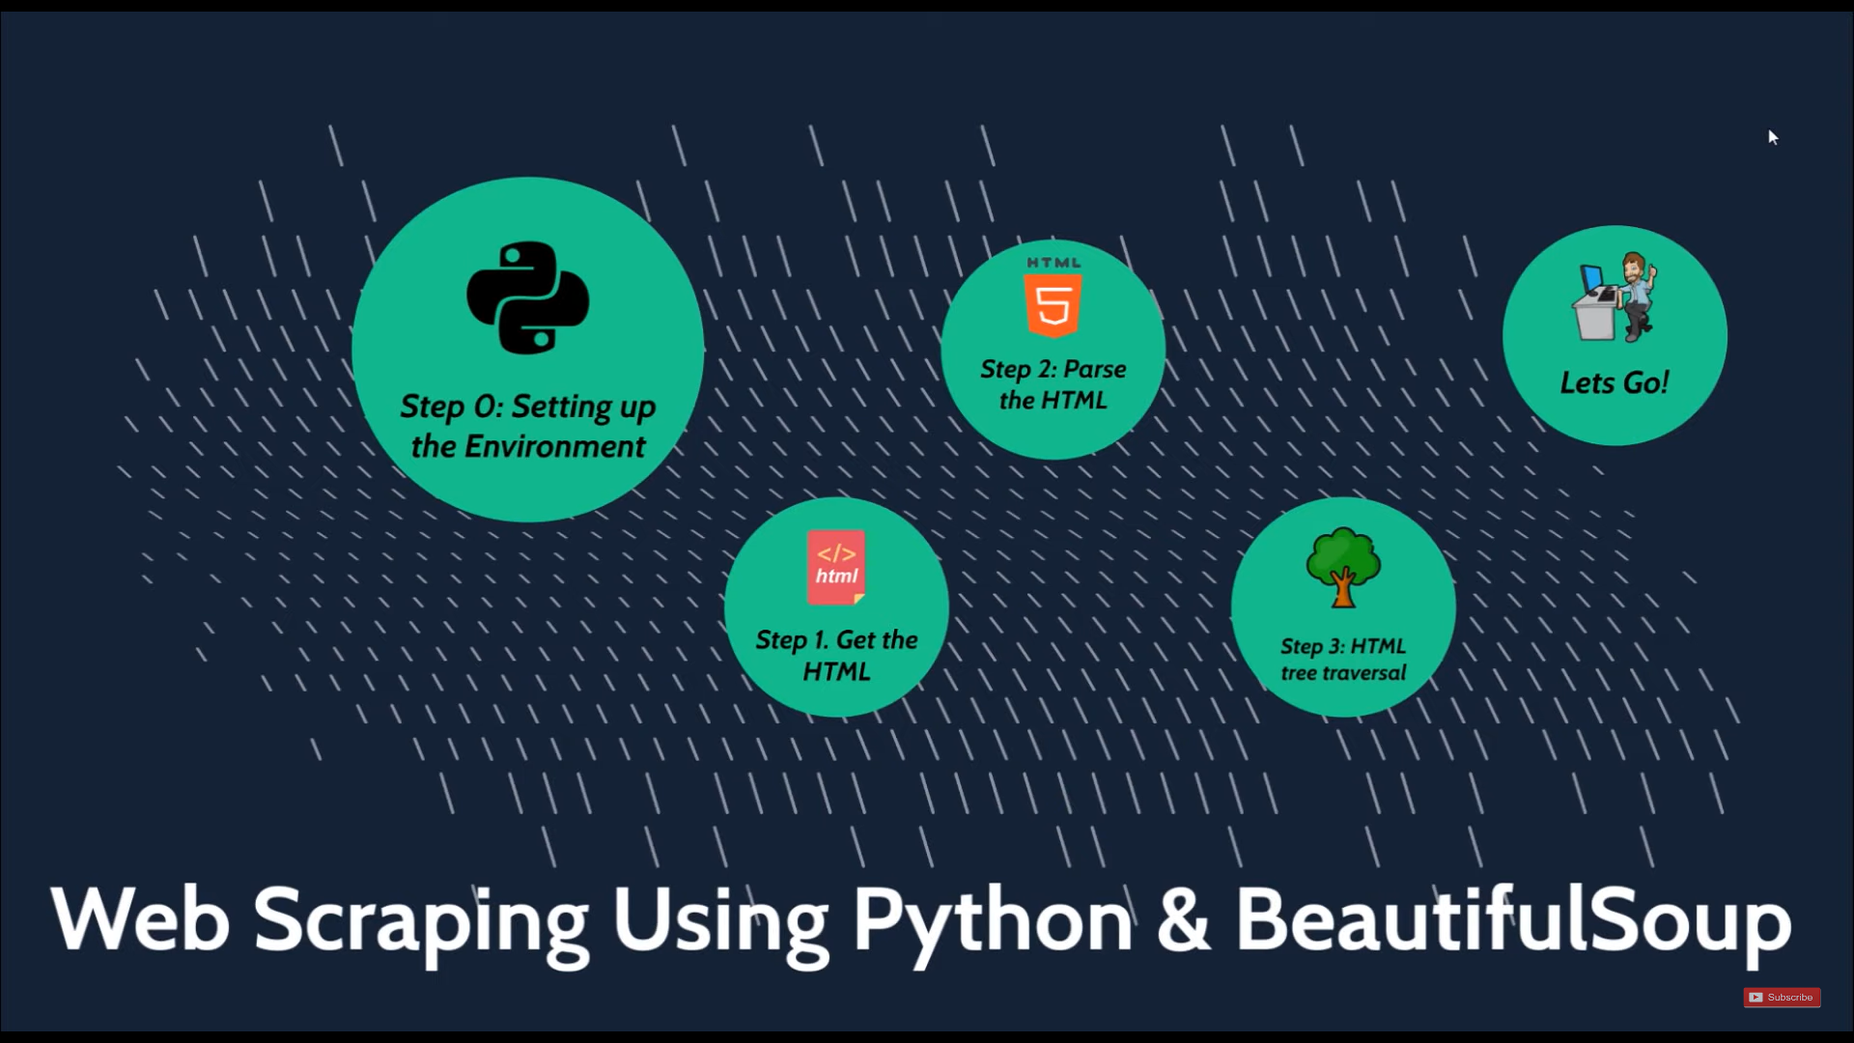

Slide 7
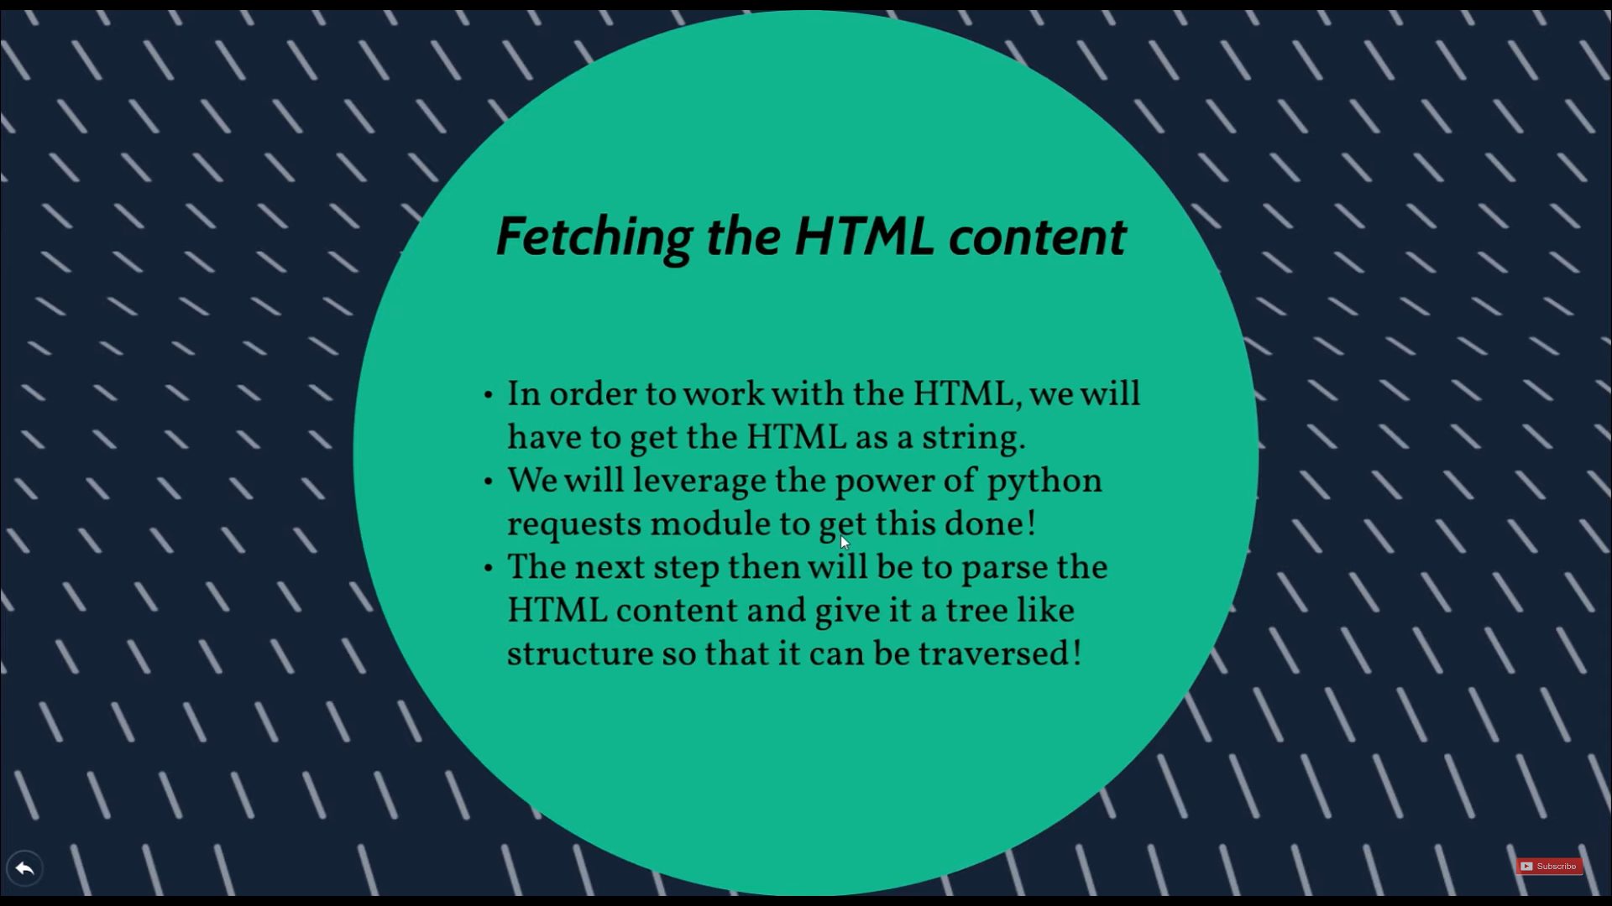

Slide 8
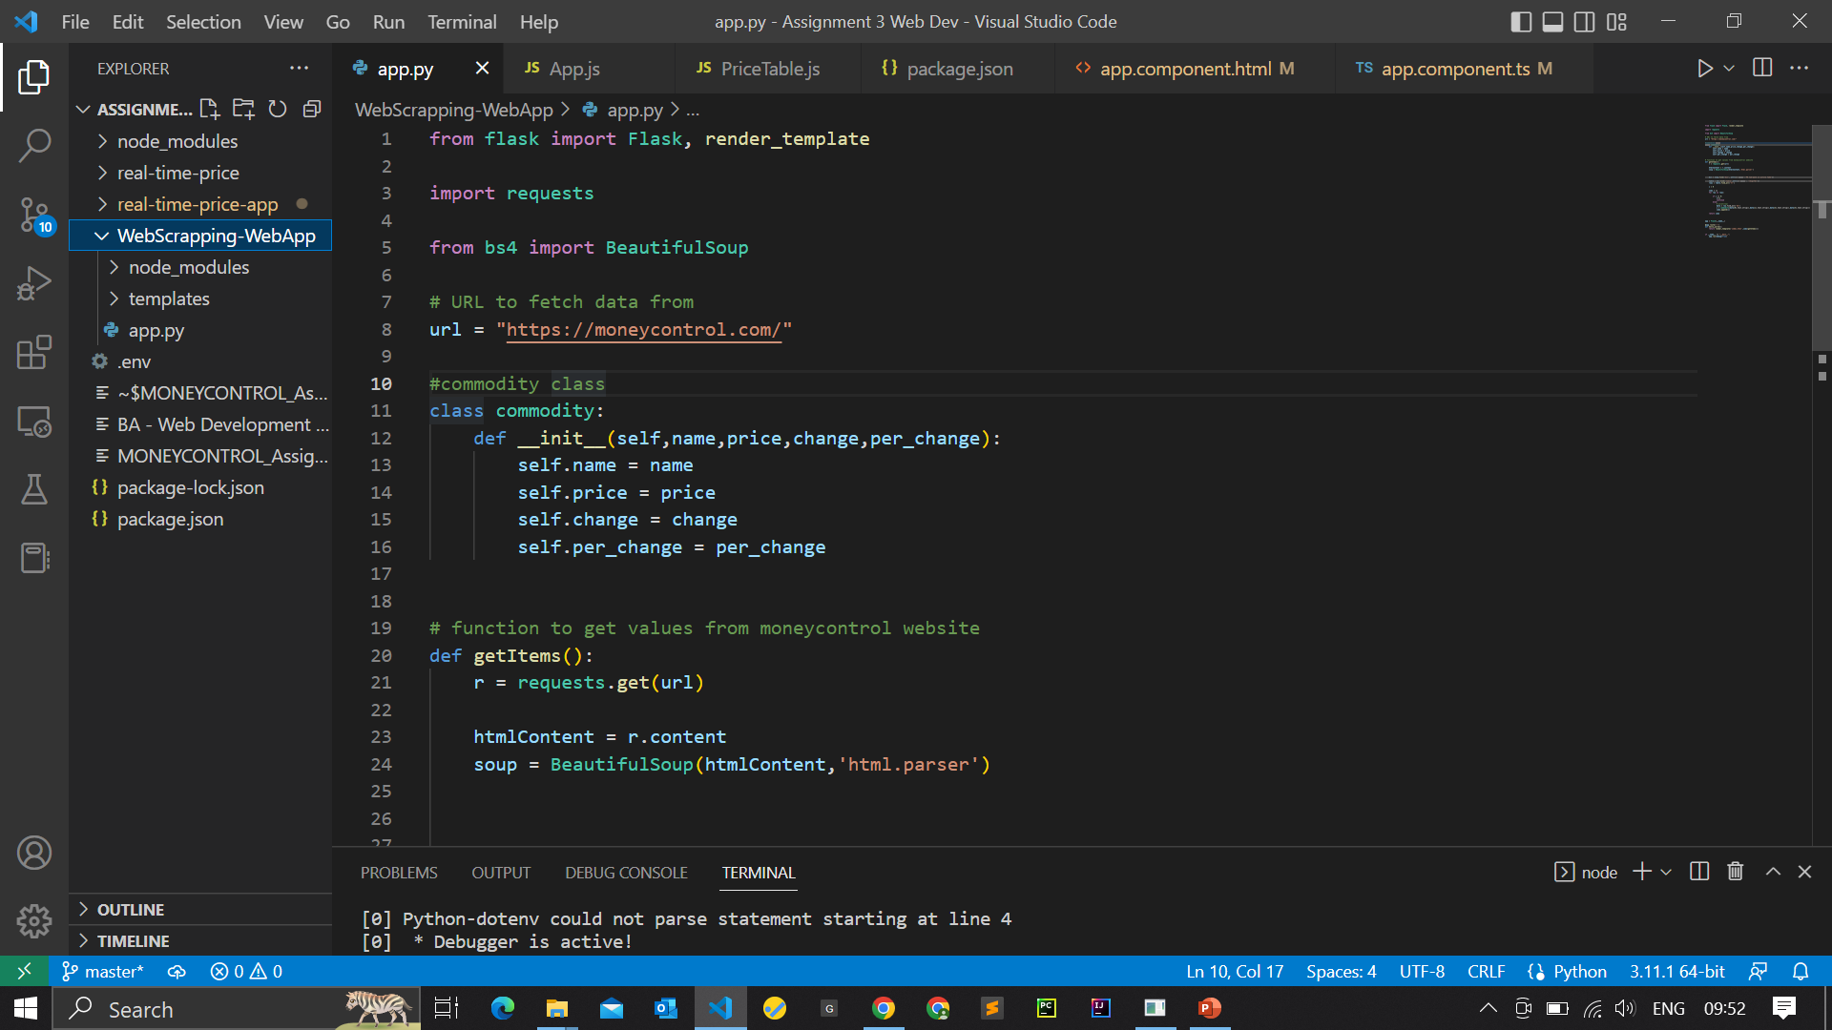

Slide 9
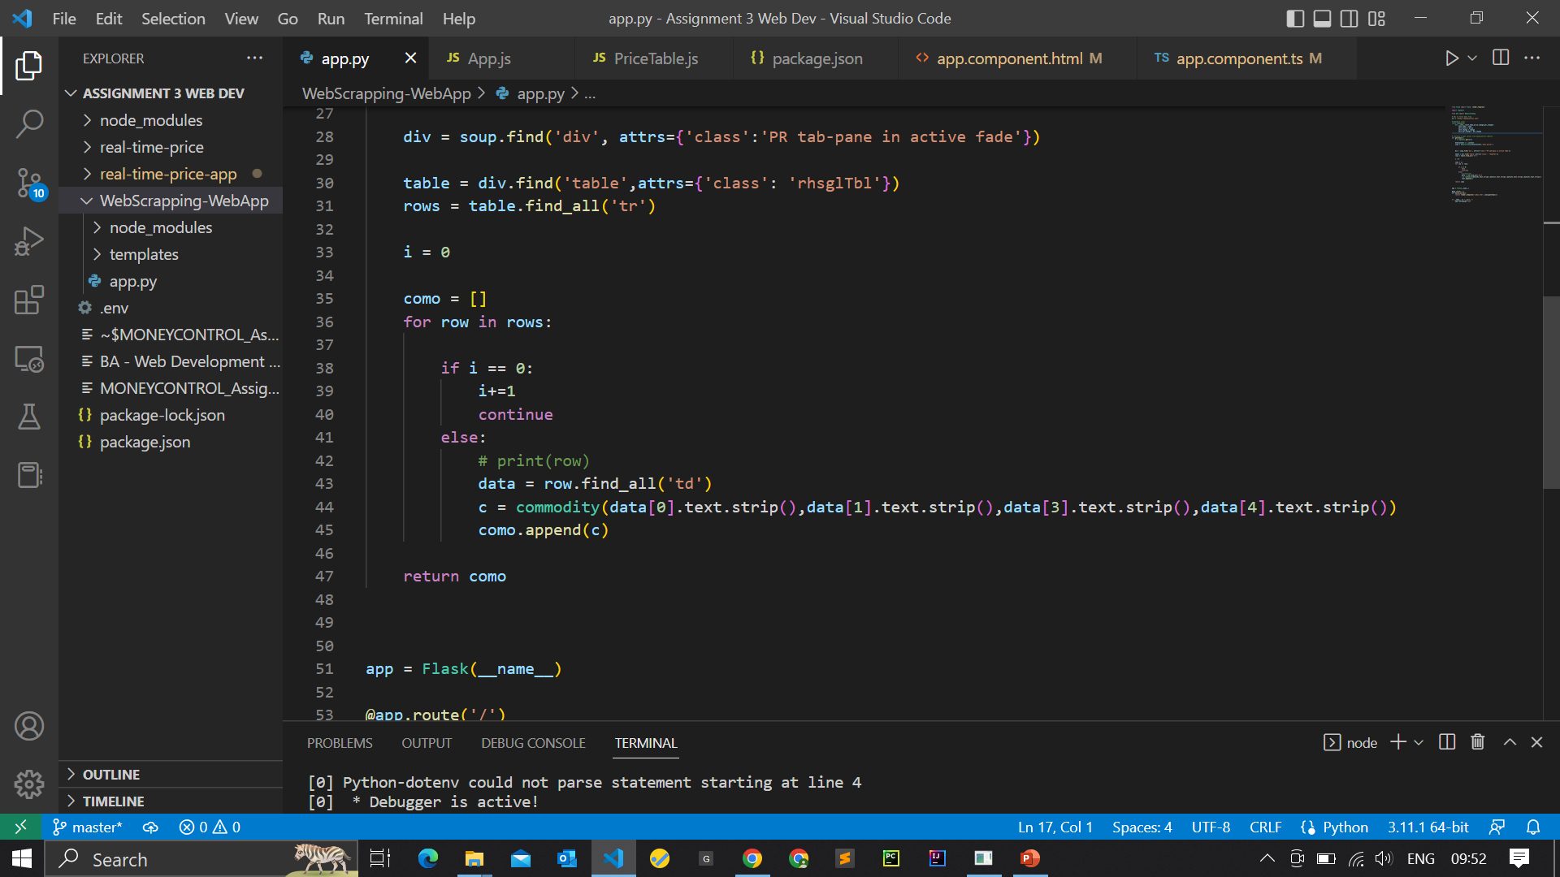

Slide 10
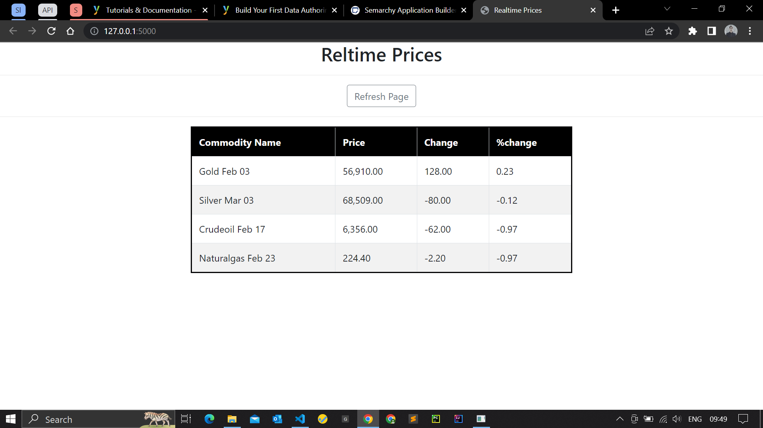
Result /Output :

Slide 11
Section: 2
React.js
JS library
Angular
JS Framework

Slide 12
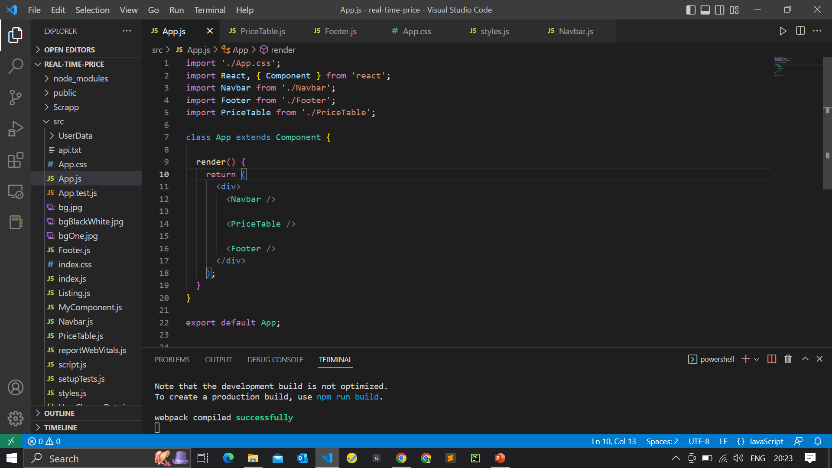
Using React.JS

Slide 13
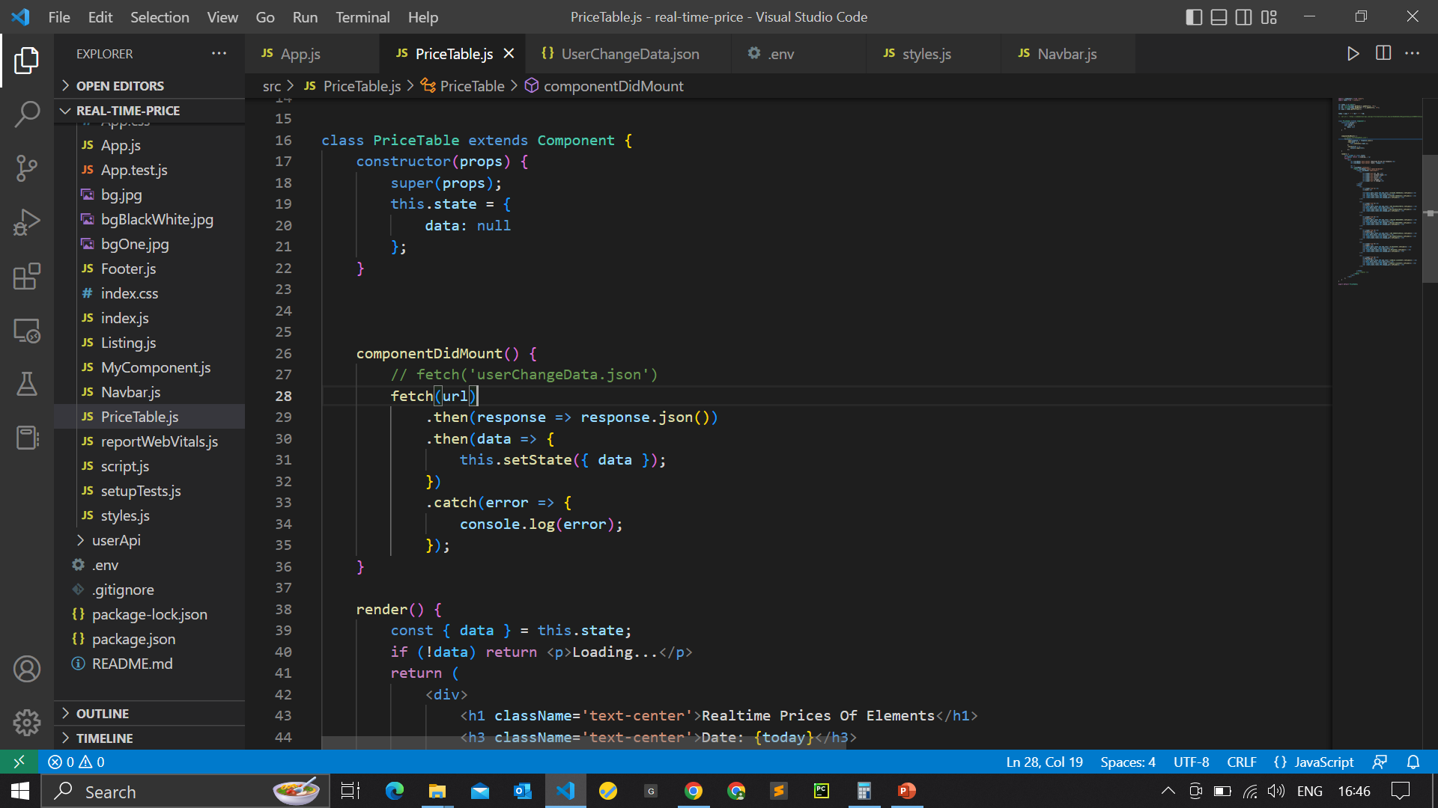

Slide 14
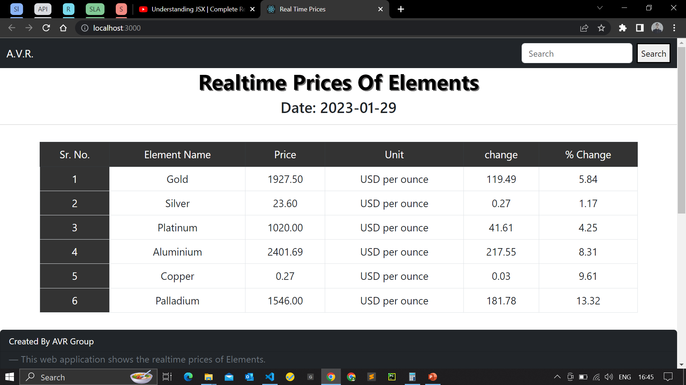
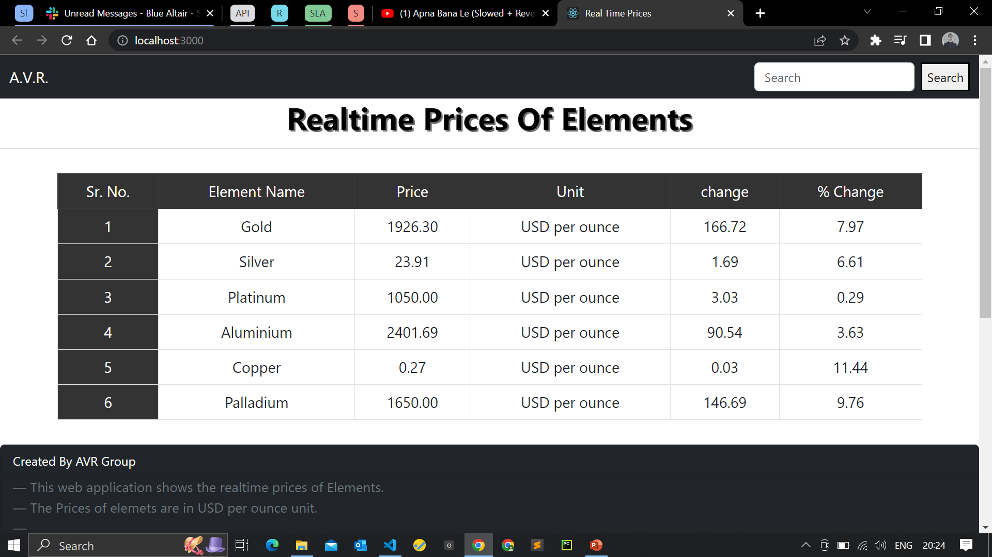
Output:

Slide 15
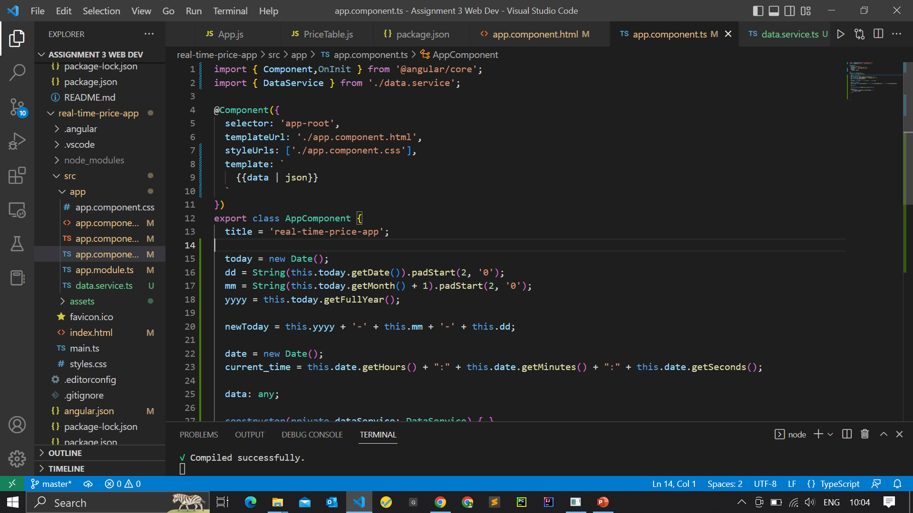
Using Angular.JS

Slide 16
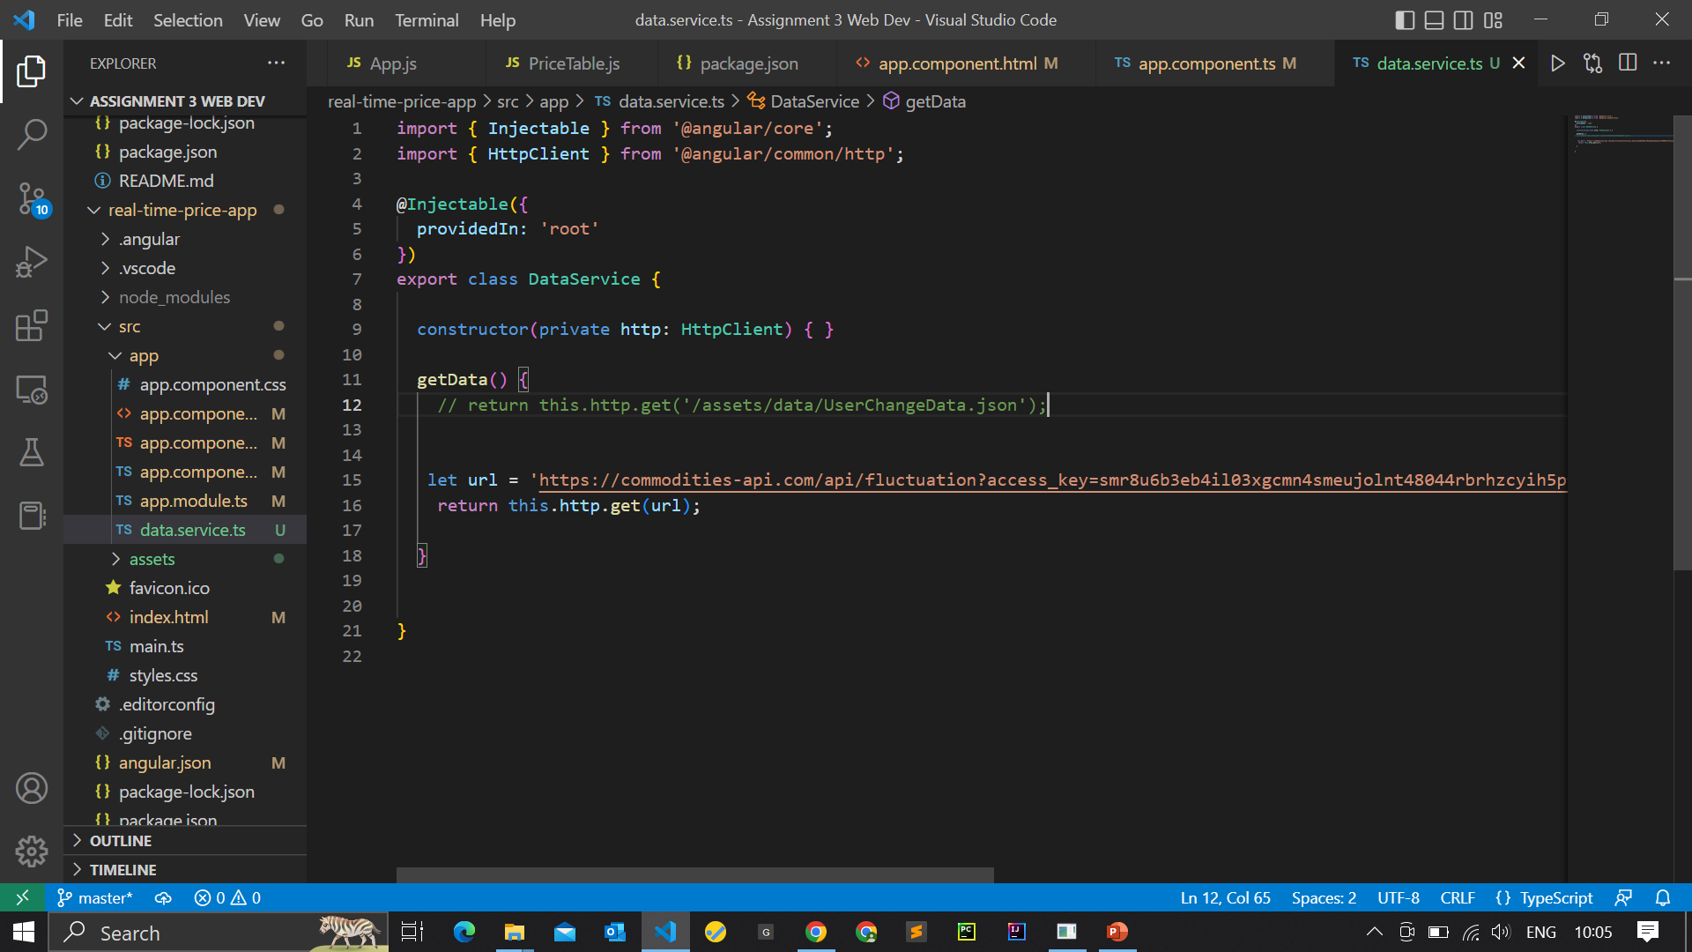

Slide 17
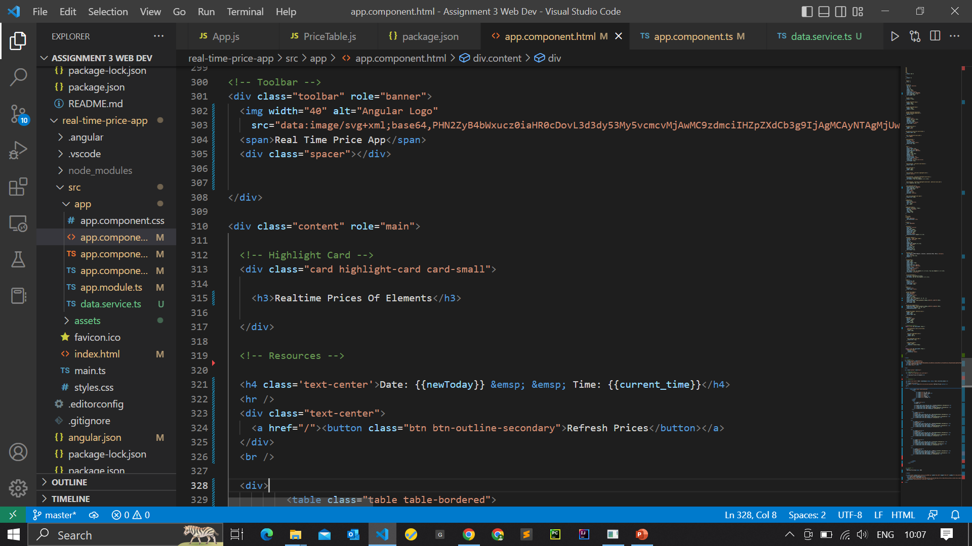

Slide 18
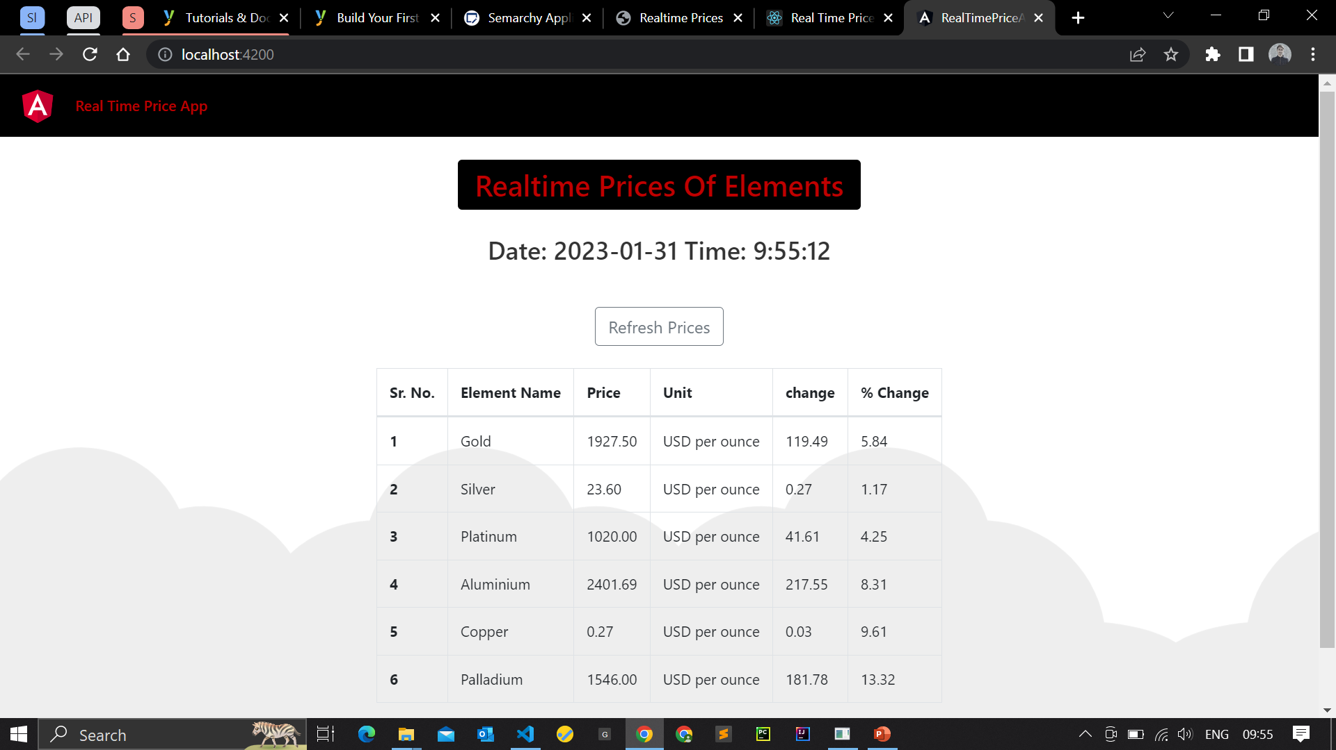
Output:

Slide 19
THANK YOU

